Slide 1
Recommendation system
Edit by Mustafa Adel

Slide 2
Introduction to recommendation engines.
Even though peoples’ tastes may vary, they generally follow patterns. people tend to like things in the same category or things that share the same characteristics.
People also tend to have similar tastes to those of the people they’re close to in their real lives.
Recommender systems try to capture these patterns and similar behaviors, to help predict what else the user might like.

Slide 3
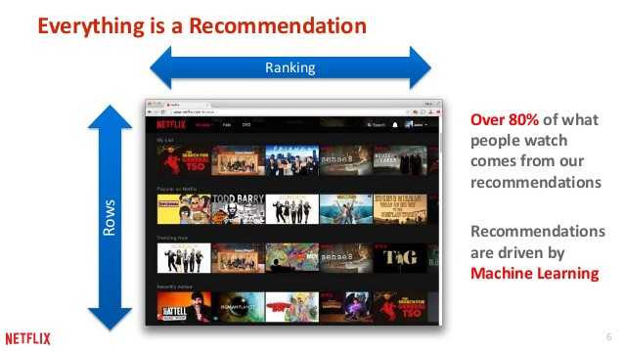
Whether you realize it or not, recommendations drive so many of our decisions on a daily basis.
Obvious recommendations such as suggestions of new restaurants from friends, or a certain model of camera discussed in a blog, to less direct recommendations such as Netflix promoting shows you are likely to enjoy, or Amazon proposing other purchases that go well with what you are buying.

Slide 4
The main benefits of using a recommendation system.
Users get a broader exposure to many different products they might be interested in. This exposure encourages users towards continual usage or purchase of their product.
Not only does this provide a better experience for the user but it benefits the service provider, as well, with increased potential revenue.

Slide 5
There’re several approaches for recommendation system, such as
Content-based
Collaborative filtering
Session based
Reinforcement based
Multi-criteria
Risk-aware
Mobile recommender
Hybrid recommender
Visit research gate for more approaches. https://www.researchgate.net/search.Search.html?type=publication&query=Recommendation%20systems

Slide 6
In this session, We will focus on…
Non-personalized
Content-based recommender
Data collation
Collaborative filtering

Slide 7
Implicit vs. explicit data collation
Explicit | Implicit
It uses the user's actions and behavior to summarize their preferences. | It contains direct feedback or rate from a user as to how he feels about an item.
Skip the video before it ends, or watch it to the end. Watch certain programs. Adding it to a wish list. Save an item to watch later. The time spent on an article. Viewing an item twice. Screen shots or save photo. Search history. Notifications. Device Ip address ………. ETC | Like or dislike or react on a post. Comment. Numerical rating (scale of 1 to 5) Upvoting or downvoting. I don’t care. ……ETC

Slide 8
Non-personalized recommendations.
The most basic ways to make recommendations
Non-personalized recommendations are made to all users, without taking their preferences into account.
The most basic ways.
To go with the knowledge of the crowd and recommend what is already the most popular (Trending)
This might not select the best items or items that are most suited to the user, but there is a good chance that the user will not hate them as they are so common.
Recommending items with the highest rated in average.
It has a serious weakness, as a movie may have been rated too few times, and with very low numbers of ratings or very infrequently-viewed movies have a solid chance of its only rating being 5 stars, pushing it to the top, while a movie that has been reviewed hundreds of times is likely to have at least one non- perfect review.

Slide 9
Combining popularity and reviews
it combines both the ratings of an item and how frequently it has been interacted with.
Recommending the items most frequently seen together (items in pairs).
To find all pairs of items or all permutations of pairs of movies that have been watched by the same user and find the most commonly pairs.
Conclusion, Non-personalized recommender system is neither random nor systematic, but the simplest description of it: Non-personalized is not-intelligent.

Slide 10
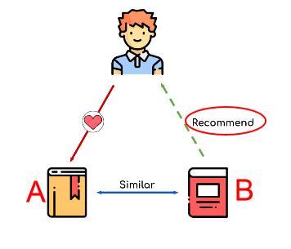
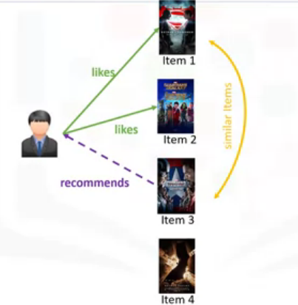
content-based recommendations
More targeted models by recommending items based on their similarities to items a user has liked in the past.
Content-based recommendation system tries to recommend items to users based on their profile and similarity among items.
For instance
if a user likes book A,
and we calculate that book A
and book B are similar,
we believe the user will like book B.
if we have four movies, and if the user likes or rates the first two items, and if Item 3 is similar to Item 1 in terms of their genre, the engine will also recommend Item 3 to the user

Slide 11
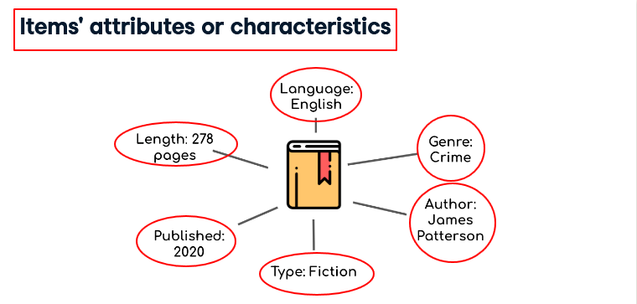
How to calculate the similarity
comparing the attributes of our items.
Similarity or closeness of items is measured based on the similarity in the content of those items.
When we say content, we're talking about things like the items category, genre, and so on.
For example content of a book could be the author of the book, its publishing date, its length, or its genre, and any descriptive information.

Slide 12
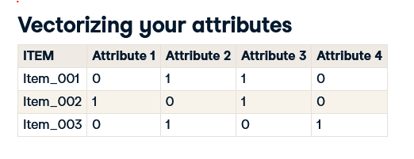
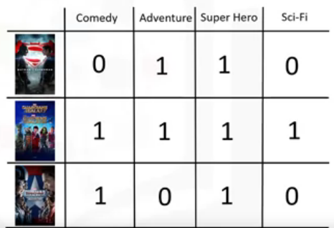
Vectorizing the attributes
by encoding each item as a vector.
This table contains a one to many reference
(One-to-many relationship)
It contains a single row per item,
and the columns are the attributes,
encoding whether or not it has that attribute
This format is extremely valuable to calculate the distance and similarities between items

Slide 13
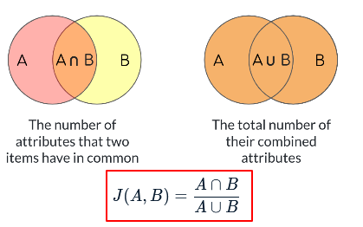
Finding the distance among items
The metric we will use to measure similarity among items is called the Jaccard similarity.
The ratio of attributes that two items have in common
divided by the total number of their combined attributes.
It will always be between 0 and 1
and the more attributes the two items have in common,
the higher the score.
It calculates the similarity between two items at ones,
But to calculate all similarities at once.
you can use pairwise distance from scipy.

Slide 14
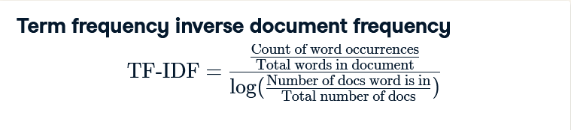
Text-based similarities
We can use Text-based similarity when descriptive information is available. Working without clear attributes
Unfortunately, in the real world, this is often not the case as attribute labels such as book genres might not be available.
if there is text tied to an item then we may still be in luck. This could be a plot summary, an item description, or even the contents of a book itself.
For this kind of data, we use Term Frequency Inverse Document Frequency or TF-IDF to transform the text into something usable.
TF-IDF divides the number of times a word occurs in a document by a measure of what proportion of all the documents a word occurs in. This has the effect of reducing the value of common words while increasing the weight of words that do not occur in many documents.

Slide 15
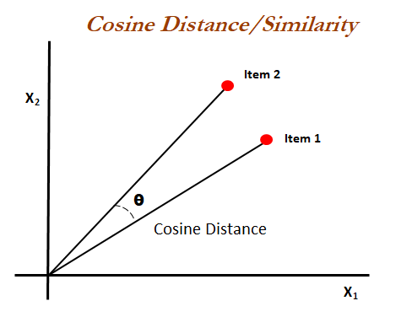
Cosine similarity
It's the measure of the angle between two documents in the high dimensional metric space as seen on this two-dimensional example.
All values are between 0 and 1
where 1 is an exact match.

Slide 16
How do we build a user-profile ?
The user's profile revolves around that user's preferences and tastes. It is shaped based on user ratings, including the number of times that user has clicked on different items or perhaps even liked those items.
create a vector of user's ratings for the movies that they have already watched.
encode the movies, Vectorizing the attributes
multiply these two matrices we can get the weighted feature set for the movies. This matrix is also called the Weighted Genre matrix and represents the interests of the user for each genre based on the movies that she's watched.
Now, we can aggregate the weighted genres.
then normalize them to find the user profile.
It clearly indicates what every user likes. We use this profile to figure out what movie is proper to recommend to this user.

Slide 17
To choose one movie of the candidate movies to be recommended to the user.
simply multiply the User Profile matrix by the candidate Movie Matrix, which results in the Weighted Movies Matrix. It shows the weight of each genre with respect to the User Profile.
aggregate these weighted ratings, we get the user's possible interest level in these three movies.

Slide 18
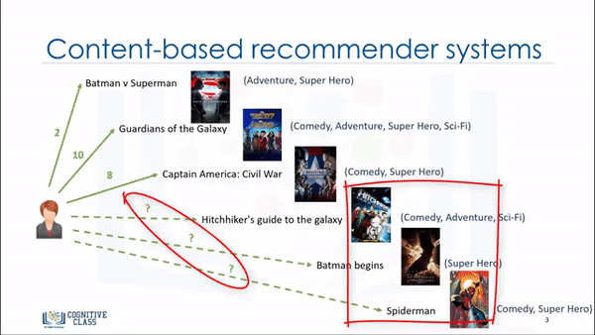
Content-based
How to build a user-profile

Slide 19
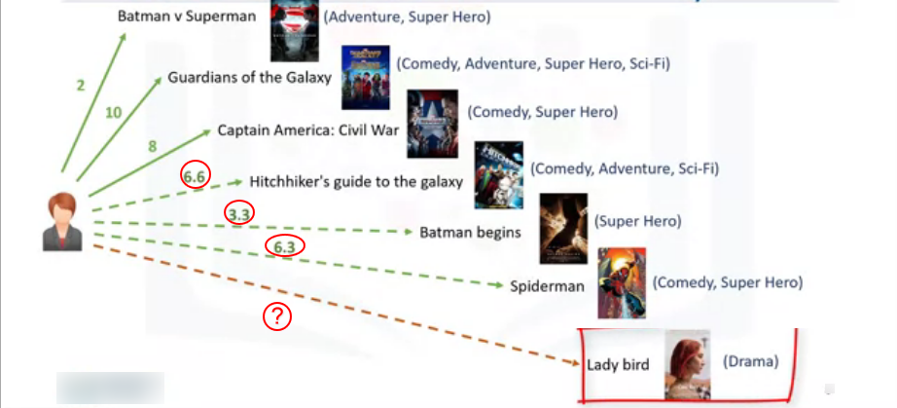
Content-based weakness
New items or new users
In some cases, it doesn't work. For example, assume that we have a movie in the drama genre, which the user has never watch. So, this genre would not be in her profile.

Slide 20
Collaborative filtering
Collaborative filtering is based on the fact that relationships exist between products and people's interests.
Many recommendation systems use collaborative filtering to find these relationships and to give an accurate recommendation of a product that the user might like or be interested in.
Collaborative filtering has basically two approaches:
user-based and item-based.
User-based collaborative filtering is based on the user similarity or neighborhood with whom he or she shares common preferences.
Item-based collaborative filtering is based on similarity among items, but it’s not content-based similarity, it’s based on rating vectors consisting of received user ratings

Slide 21
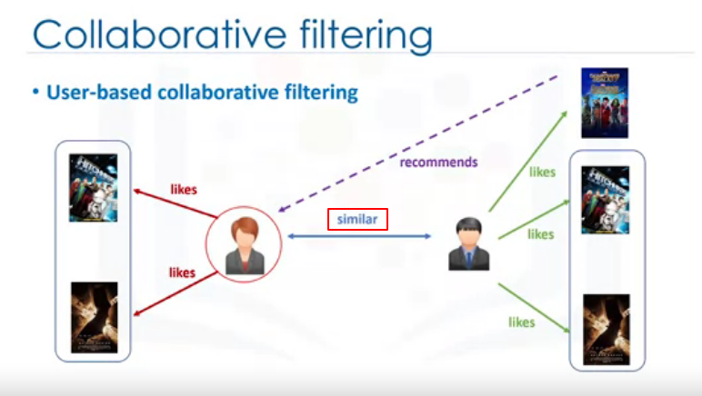
user-based collaborative filtering
The collaborative filtering engine first looks for users who are similar. this similarity is based on things like history, preference, and choices that users make when buying, watching, or enjoying something.
Movies that similar users have rated highly. Then it uses the ratings from these similar users to predict the possible ratings by the active user for a movie that the user had not previously watched.
For instance, if two users are similar or are neighbors in terms of their interested movies, we can recommend a movie to the active user that her neighbor has already seen.

Slide 22
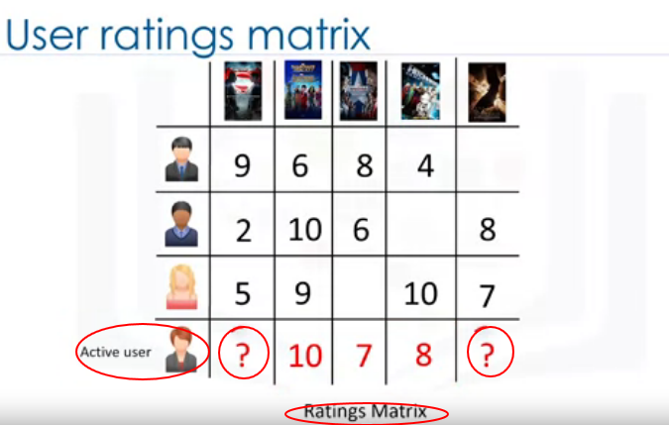
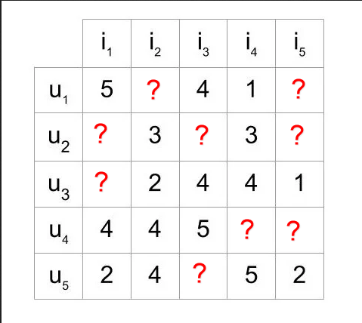
how similar the active user is to the other users.
This can be done through several different statistical and vectoral techniques such as distance or similarity measurements including Euclidean Distance, Pearson Correlation, Cosine Similarity.

Slide 23
The next step is to create a weighted rating matrix to calculate the possible opinion or rate of the active user about our two target movies. This is achieved by multiplying the similarity weights to the user ratings.
It results in a weighted ratings matrix, which represents the user's neighbors opinion about are two candidate movies for recommendation. In fact, it incorporates the behavior of other users and gives more weight to the ratings of those users who are more similar to the active user. Now, we can generate the recommendation matrix by aggregating all of the weighted rates. However, as three users rated the first potential movie and two users rated the second movie, we have to normalize the weighted rating values. We do this by dividing it by the sum of the similarity index for users. The result is the potential rating that our active user will give to these movies based on her similarity to other users. It is obvious that we can use it to rank the movies for providing recommendation to our active user.

Slide 24
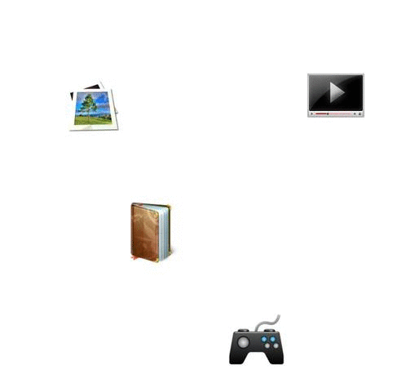
Collaborative filtering

Slide 25
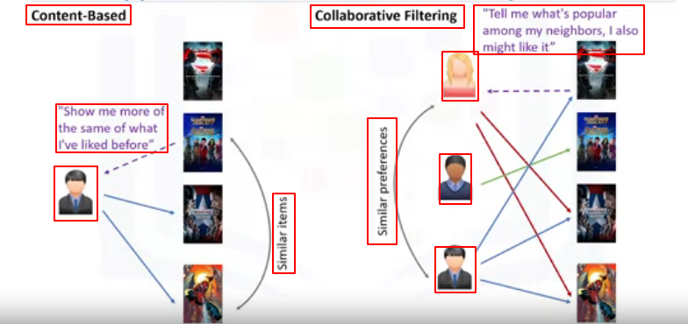
Content-based Vs collaborative filtering
The main difference between each, can be summed up by the type of statement that a consumer might make. The main paradigm of a Content-based recommendation system is driven by the statement: “Show me more of the same of what I've liked before."
Collaborative filtering is based on a user saying, “Tell me what's popular among my neighbors because I might like it too.” Collaborative filtering techniques find similar groups of users, and provide recommendations based on similar tastes within that group.

Slide 26
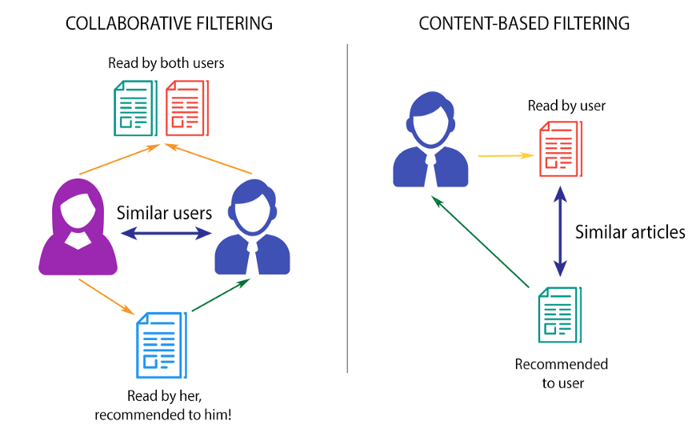

Slide 27
Recommendation system challenges.
Data sparsity happens when you have a large data set of users who generally rate only a limited number of items. As mentioned, collaborative based recommenders can only predict scoring of an item if there are other users who have rated it. Due to sparsity, we might not have enough ratings in the user item dataset which makes it impossible to provide proper recommendations.
Cold start refers to the difficulty the recommendation system has when there is a new user, and as such a profile doesn't exist for them yet. Cold start can also happen when we have a new item which has not received a rating.
Scalability. As the number of users or items increases and the amount of data expands, collaborative filtering algorithms will begin to suffer drops in performance, simply due to growth and the similarity computation. There are some solutions for each of these challenges such as using hybrid-based recommender systems.

